Slide 1
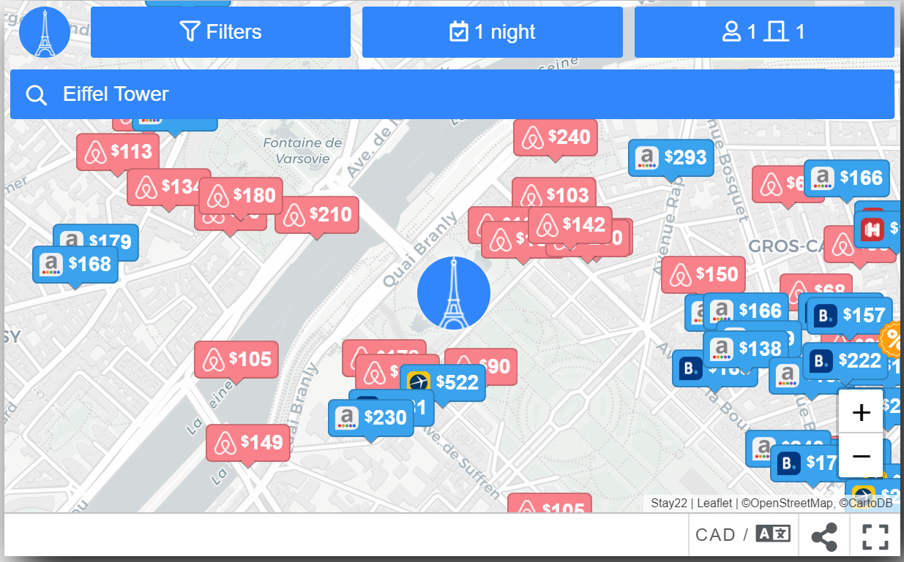

Olive Zhao Jonathan Zhang William Wu

Slide 2


Agenda
Opportunity statement
Current Situation
Get New Partners
Get New Talents
Get into New Industry
Finance & Implementation
Notes:
Opportunity statement
Current Situation
Get new partners
Get new talents
Get into new industry
Finance
Implementation

Slide 3

The Opportunity
By implementing 3-Gets strategy, Stay 22 will be positioned as a leading Price Comparing Map Provider by 2021, that services event-goers while achieving more than $344,000 revenue within next two years. In addition, profitability is estimated above $400,000 in the long term.

Slide 4
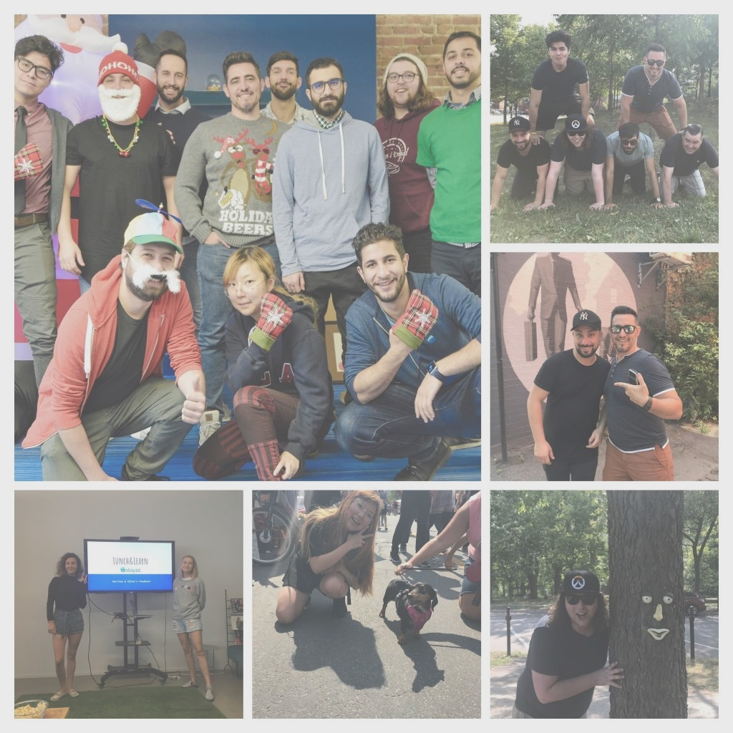
Current situation –SWOT analysis
Strengths
Largest inventory
Simple process
Strong conversion rate
Weakness
Dependence on OTA
Hard to find qualified employees
Opportunities
High quality of events in MTL
Access to expertise
Threats
New competitors

Slide 5







Get New Partners (without forgetting the old ones)
The only company in the industry to include Airbnb listings
33% of revenue comes from Airbnb
The partner we must keep
Seek for long-term cooperation and maintain exclusive partnership with Airbnb.
What to do?
What do we get?
Provide a 5% annual discount on above six-year exclusive contract with Airbnb.
Also to trade for further cooperation on our coming flight service.
Maintain the large inventory
Keep our comparative advantage.
Further low-cost advertisement on flight ticket service.
Notes:
Without forgetting the old parteners

Slide 6

Get New Partners
Where all the target partners gather
Go to Event-Planner Conference
Relatively low cost to attend
What to do?
What do we get?
Introduce who we are, what we do.
Show our excellent transcript, consolidate leading position.
Make ourselves seen and heard
To advertise ourselves with much lower cost
More accurately targeted customers and partners
Notes:
- To introduce who we are, what we do, show our excellent transcript, to make ourselves seen, heard

Slide 7


Get New Talents
Required qualities:
1. Positive attitudes.
2. Resilient mindsets.
3. Don’t require a high salary.
4. Able to learn a range of knowledge for diverse clients.
Qualities of graduates:
1. Positive thoughts.
2. Perseverance against struggles.
3. Low requirements on salary.
4. High adaptability and learning ability
Attract newly graduated students from college who have marketing and IT professions by:
Opening up cooperative education (co-op) positions in collaboration with colleges in Montreal.
Going to the conferences in colleges focused on IT and marketing.
Keep doing case competition, observe the potential candidate.
Their current openings:
Digital marketing manager IT &Marketing
Sales representative Marketing
Sales development and representative Marketing
Notes:
could transition easier into the team, show more perseverance against the struggles of an expanding startup, and be more invested in the company’s success.

Slide 8
Get New Talents – results
Notes:
到时候只用报数字差距就可以了

Slide 9
Get into New Industry – Decision Matrix
Alternatives | Profitability | Barrier to enter | Competiton | Strenthen brand image
Ticket
Parking
Train
Flight
* Note: Higher barrier and competition get lower points

Slide 10




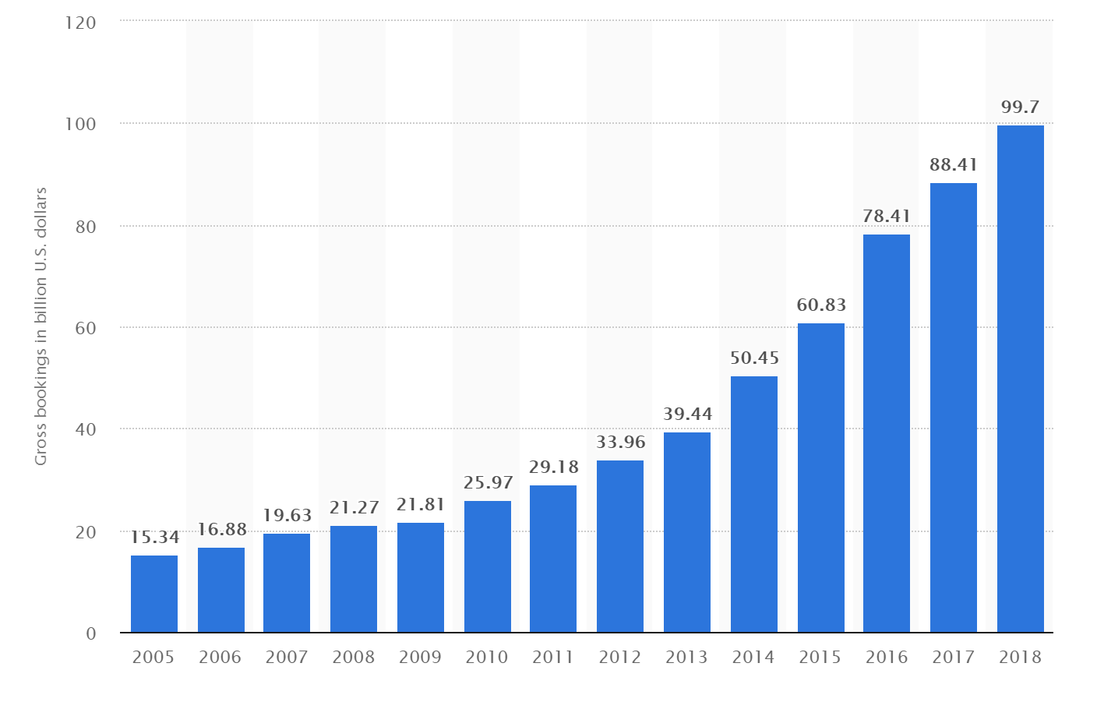
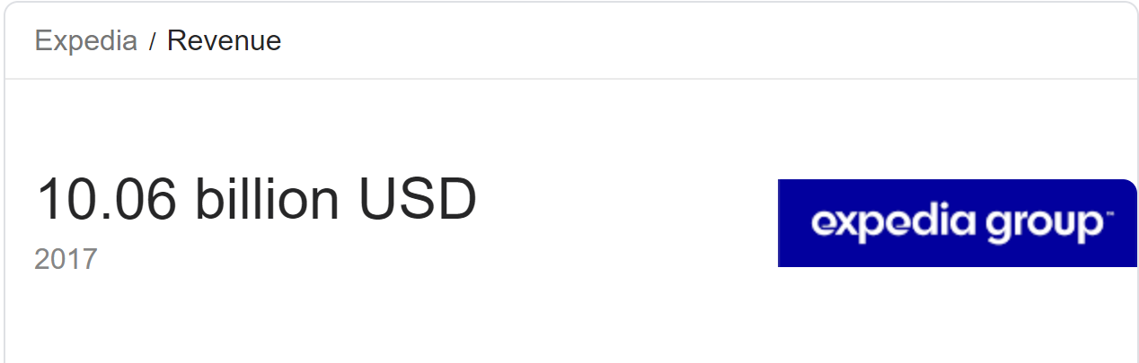
Get into New Industry: Flight tickets
Similar service nature
Transportation tickets and accommodation services share the same group of targeted customers (people who book a hotel need to get to the city first)
Huge market potential
Expedia, which is a company selling bond tickets for hotel and flight tickets, has a gross booking of 99.7 Billion dollars in 2018, with a revenue of 10.06 billion dollars in 2017. It shows that there’s a very big market for selling transportation tickets together with flight tickets.

Slide 11
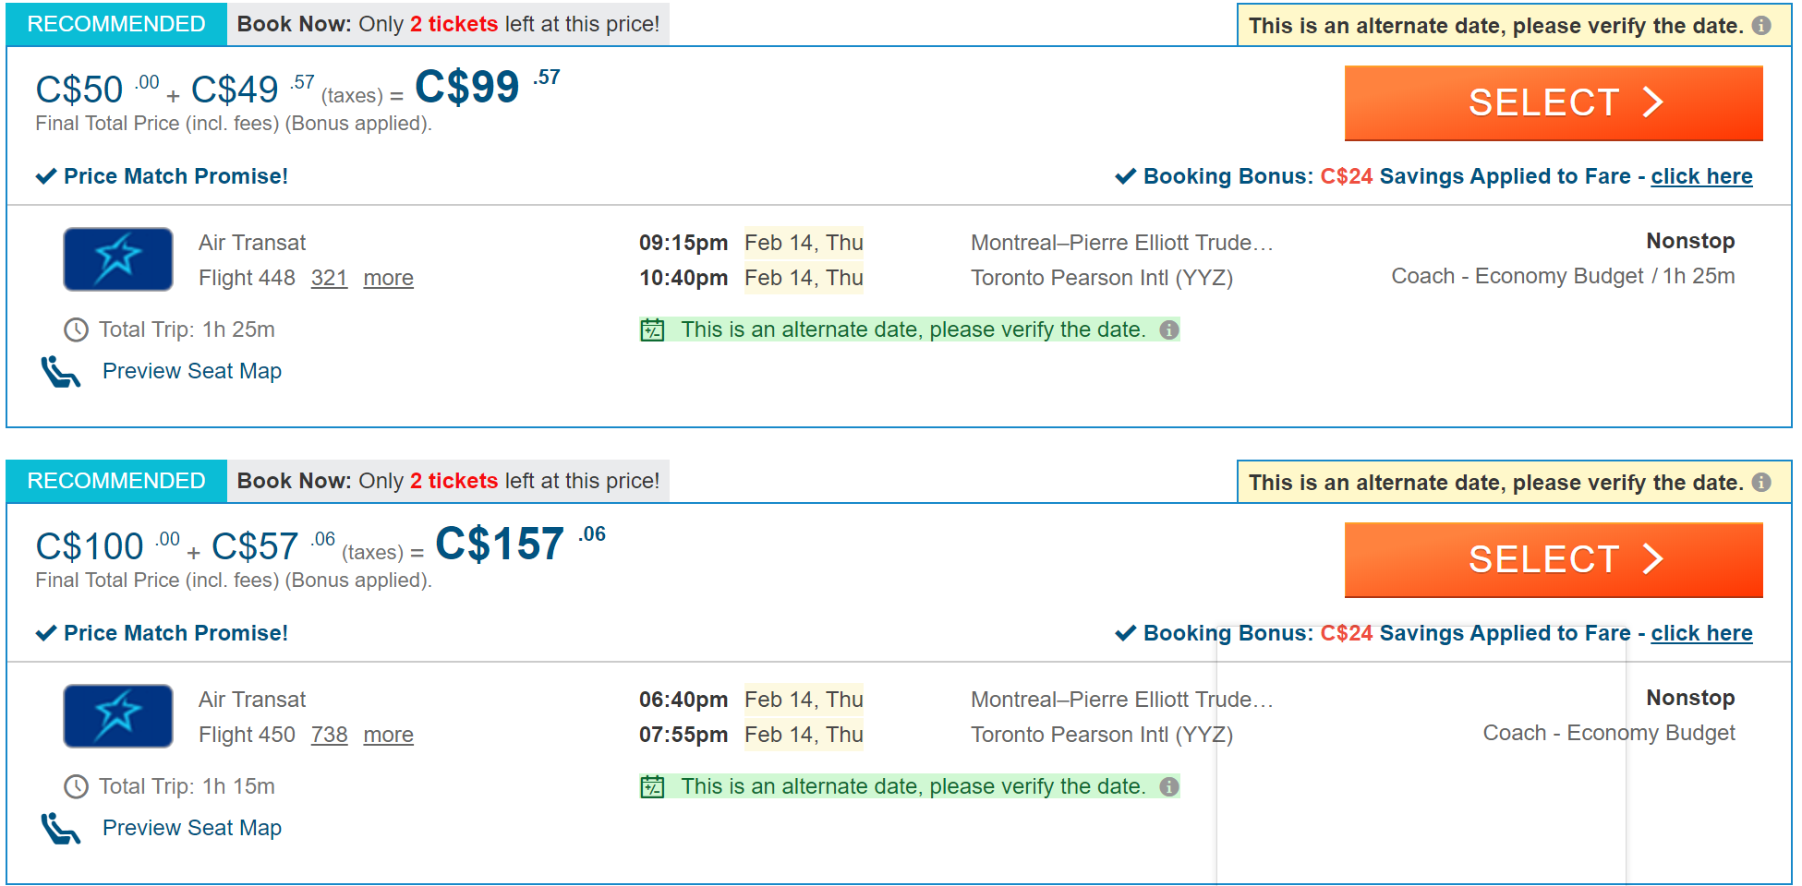
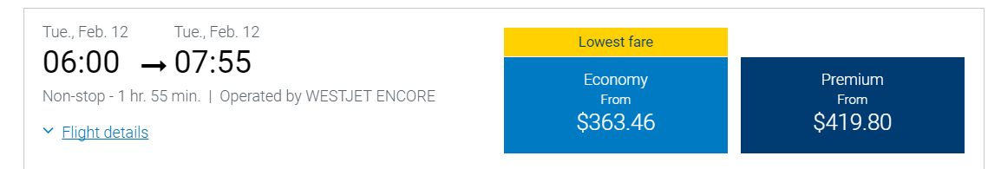
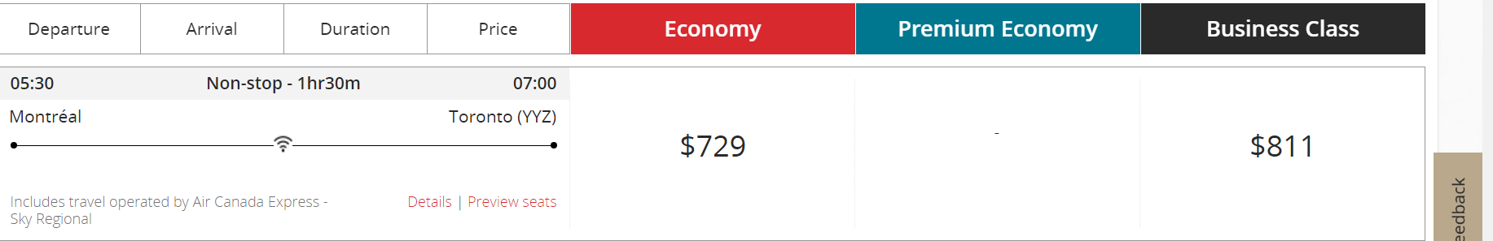
Get into New Industry: Flight tickets
Even for a flight that only takes us from Montreal to Toronto has so many different prices
Price comparability, which is one key of our service.

Slide 12
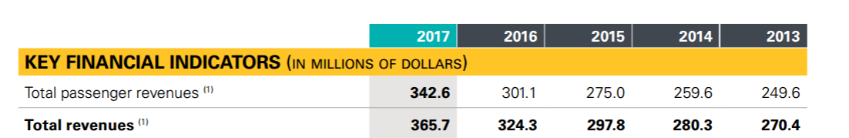

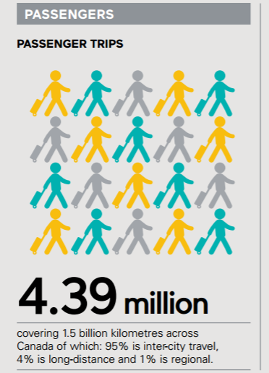
Get into New Industry: Train tickets
Generate a lot of revenue
Have large revenue potentials
Easier to add this service since there’s only one required company
Have huge potential customers
One dominant train passenger company, easier to
Huge amount of passengers every year

Slide 13






New Business model
OTA partners
Bring customers to them
Give us commission
Bring customers to us
Transportation partners
Split commission to them
Give us commission
Event websites
Bring customers to them​
Notes:
- 通过增加机票,火车票的服务，我们整合出一个更加全面，范围更广的服务。
- 因为加拿大只有一家客运火车领导，容易合作
增加更多顾客的同时，也增加revenue
同时通过增加新的服务，减少对ota的依赖性
T同时提高进入行业门槛

Slide 14

Train/Flight Tickets

Slide 15
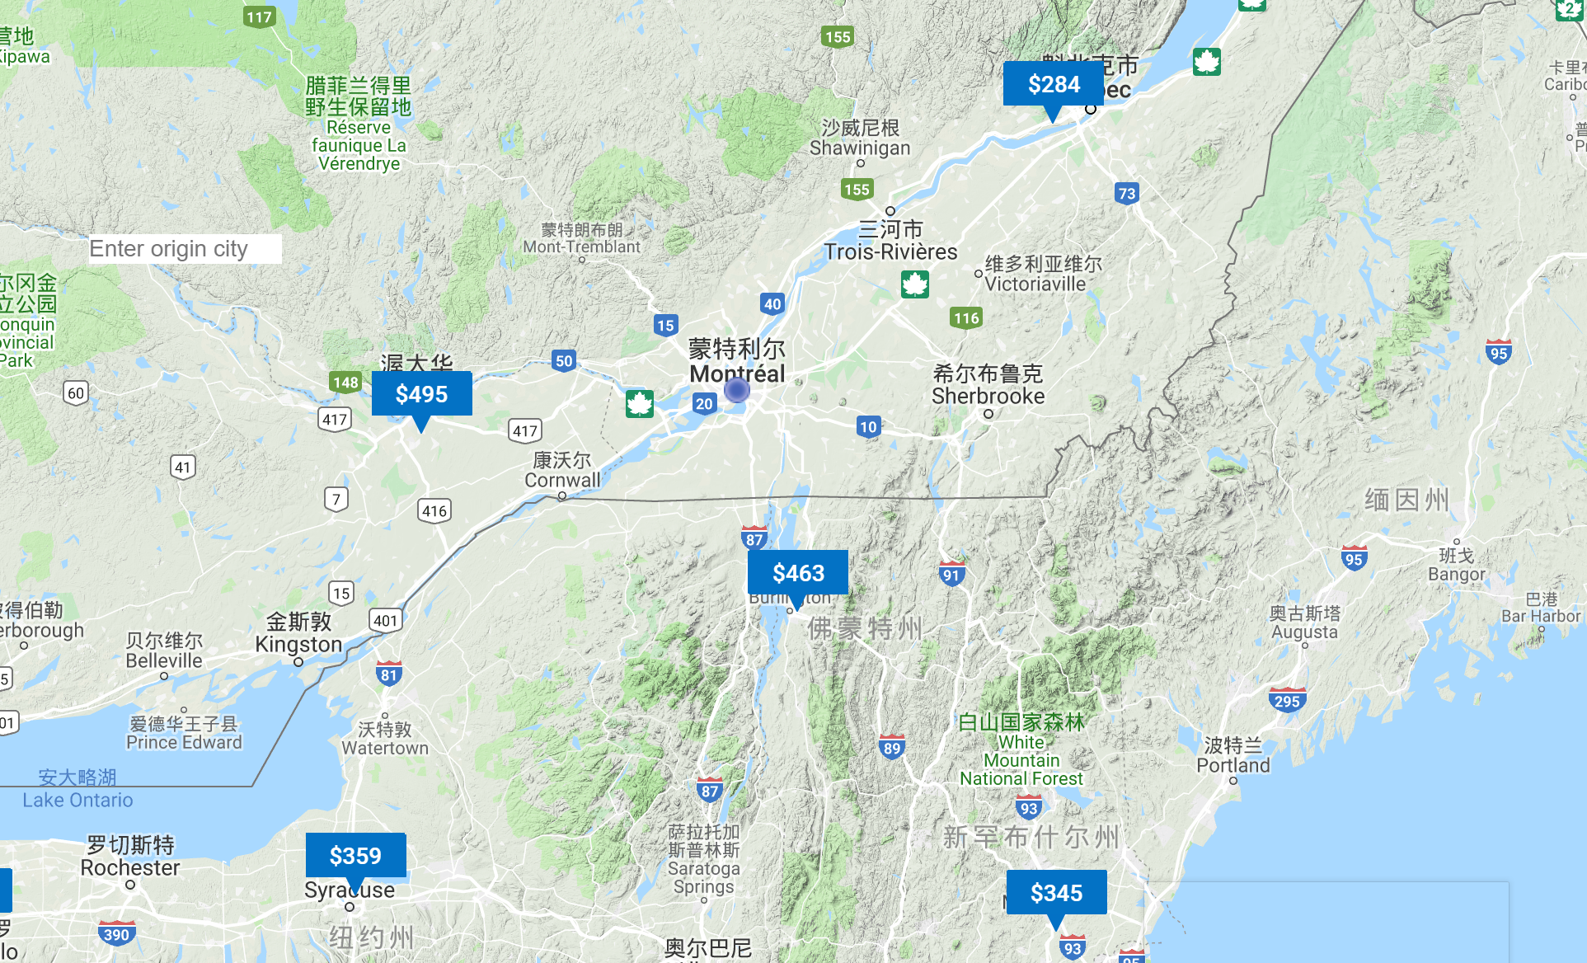

Slide 16
Finance
5% of customers buy packages.
Remain the same commission rate.
All customers will buy economy tickets for both train and flight.
Assumptions:
2019
Increase the revenue by 10%, up to 269,941 USD
2020
Increase revenue by 27.53% up to 344,267 USD
2021
Increase revenue by 13.02%, up to 389,121 USD

Slide 17
Implementation
Start applying the promotion discount for Airbnb
Go to the event-planner conferences
Start negotiating with Airline companies
Add flight ticket service on the map
2019
2020
2021
2022
Start posting co-op positions for school; Start negotiating with VIA
Add train ticket service on the map.
Check the result for train and flight ticket, make necessary requirements.
Notes:
2019: start Applying the promotion discount for Airbnb; Go to the event-planner conferences; Start posting co-op positions for school; Start negotiating with TIA
2020: Start negotiating with Airline companies; Add train ticket service on the map.
2021: Add flight ticket service on the map
2022: Check the result for train and flight ticket, make necessary requirements.

Slide 18



Key takeaway
By applying our 3-Gets strategy, Stay22 is able to…
Competitive
Remain competitive in the industry without losing potential growth.
Economic
Realize an 10% increase in customers and an Increased revenue 389,121 USD in 2021
Integration
Form a strong inter-service network that provides comprehensive services.
Notes:
Remain competitive in the industry and potential growth.
Form a strong inter-service network that provides comprehensive services.

Slide 19
Q&A
Thank you!
Presentation:
Opportunity
Current Situation
Get New Partners
Get New Talents
Get into New Industry – Decision Matrix
Get into New Industry – Flight tickets
Get into New Industry – Train tickets
New Business Model
Finance
Implementation
Key takeaways
Finance:
Finance calculation
Finance calculation (1)
Finance calculation (2)
Flight Ticket Prices
Train Ticket Prices
Strategy
Get New Partners
Get New Talents
Staff Distribution

Slide 20
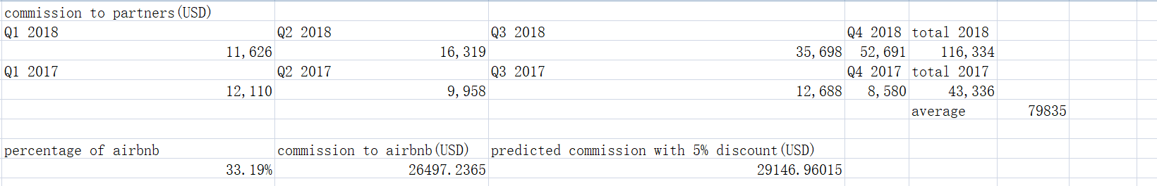
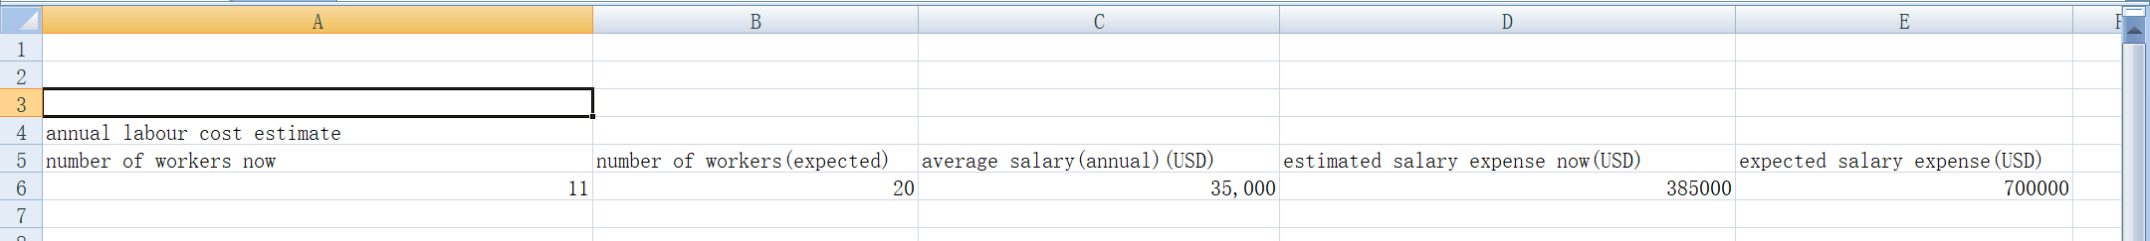
Finance calculation

Slide 21
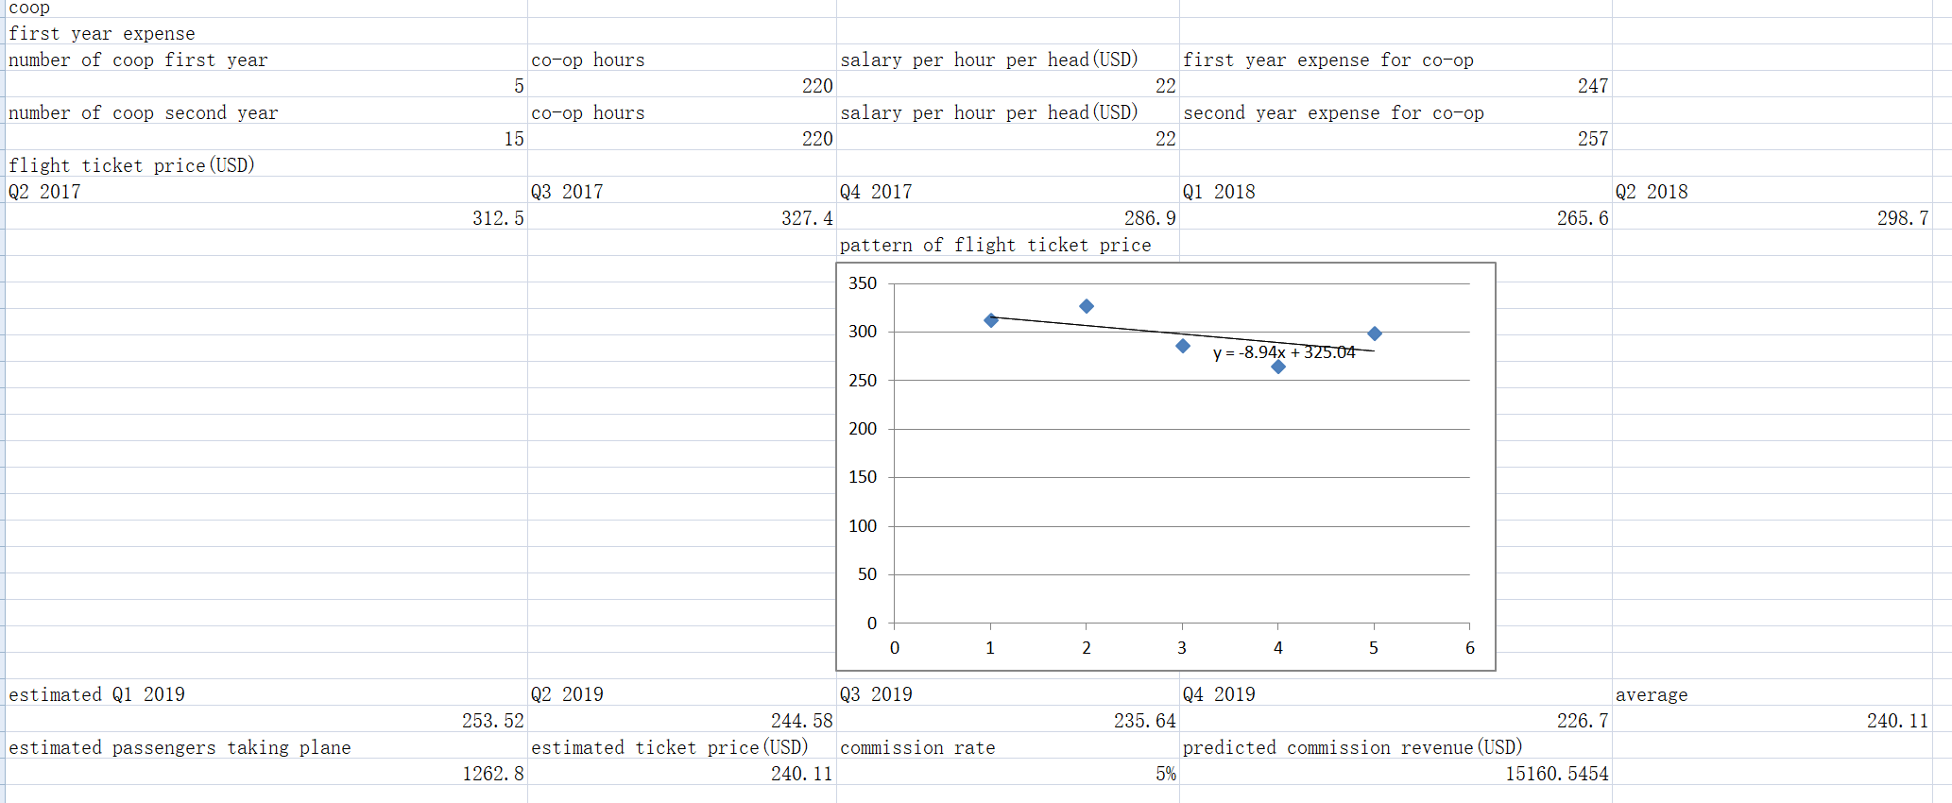
Finance calculation (continued)

Slide 22
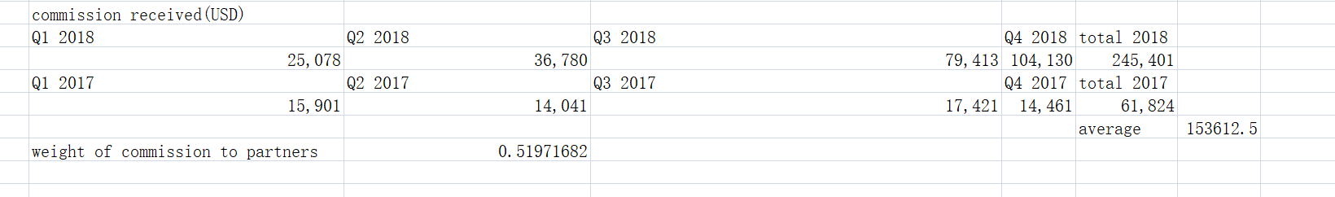
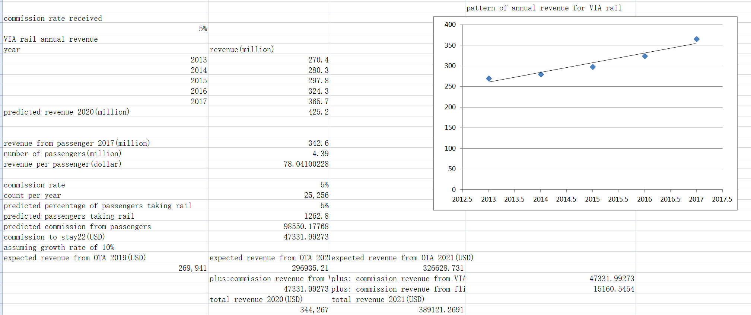
Finance calculation (continued)

Slide 23
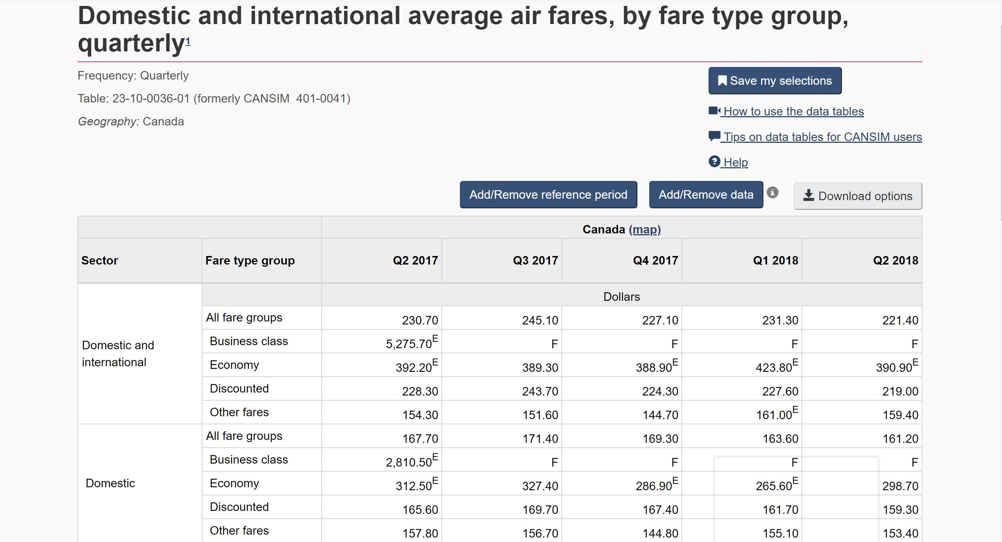
Finance calculation (flight ticket price)
Sources are from: Statistic Canada https://www150.statcan.gc.ca/t1/tbl1/en/tv.action?pid=2310003601

Slide 24
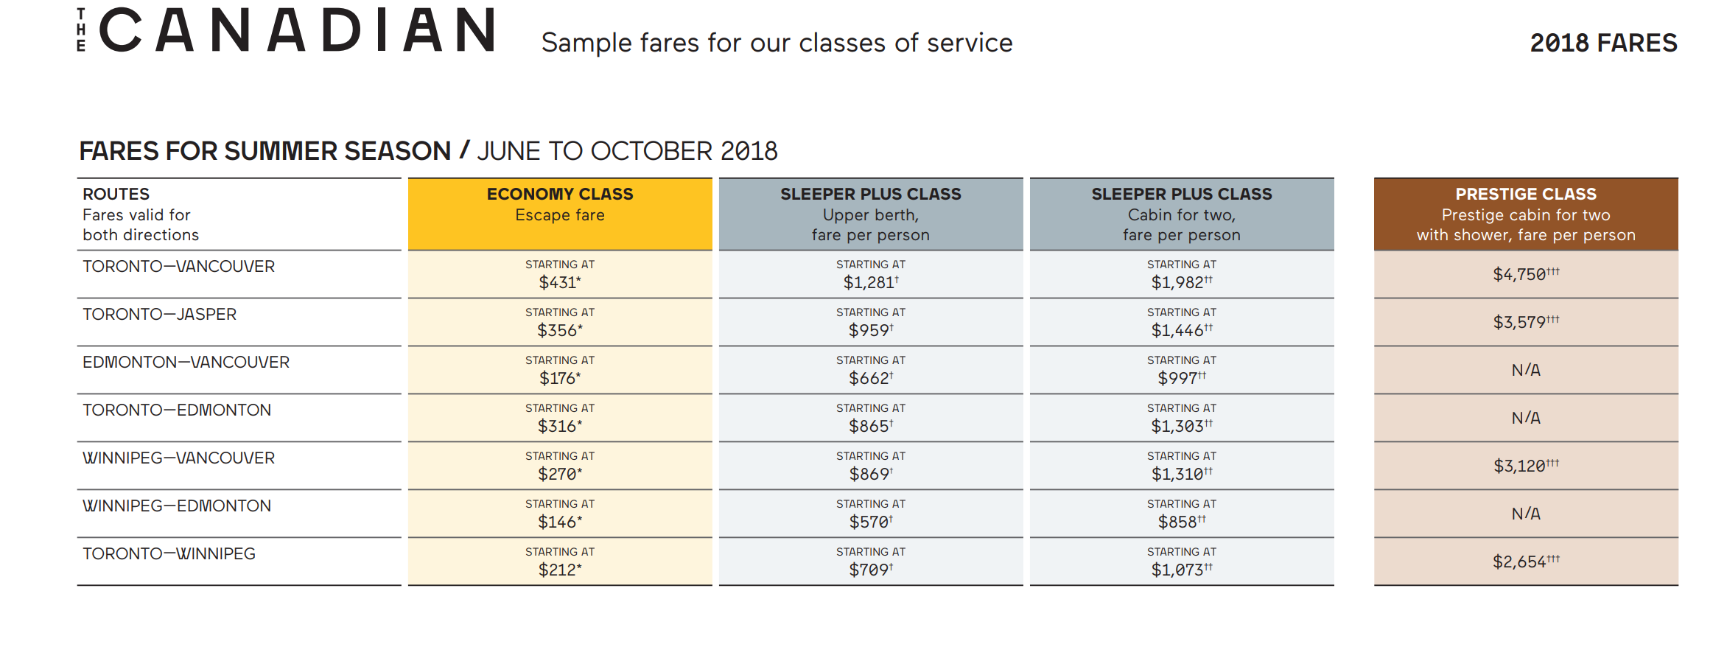
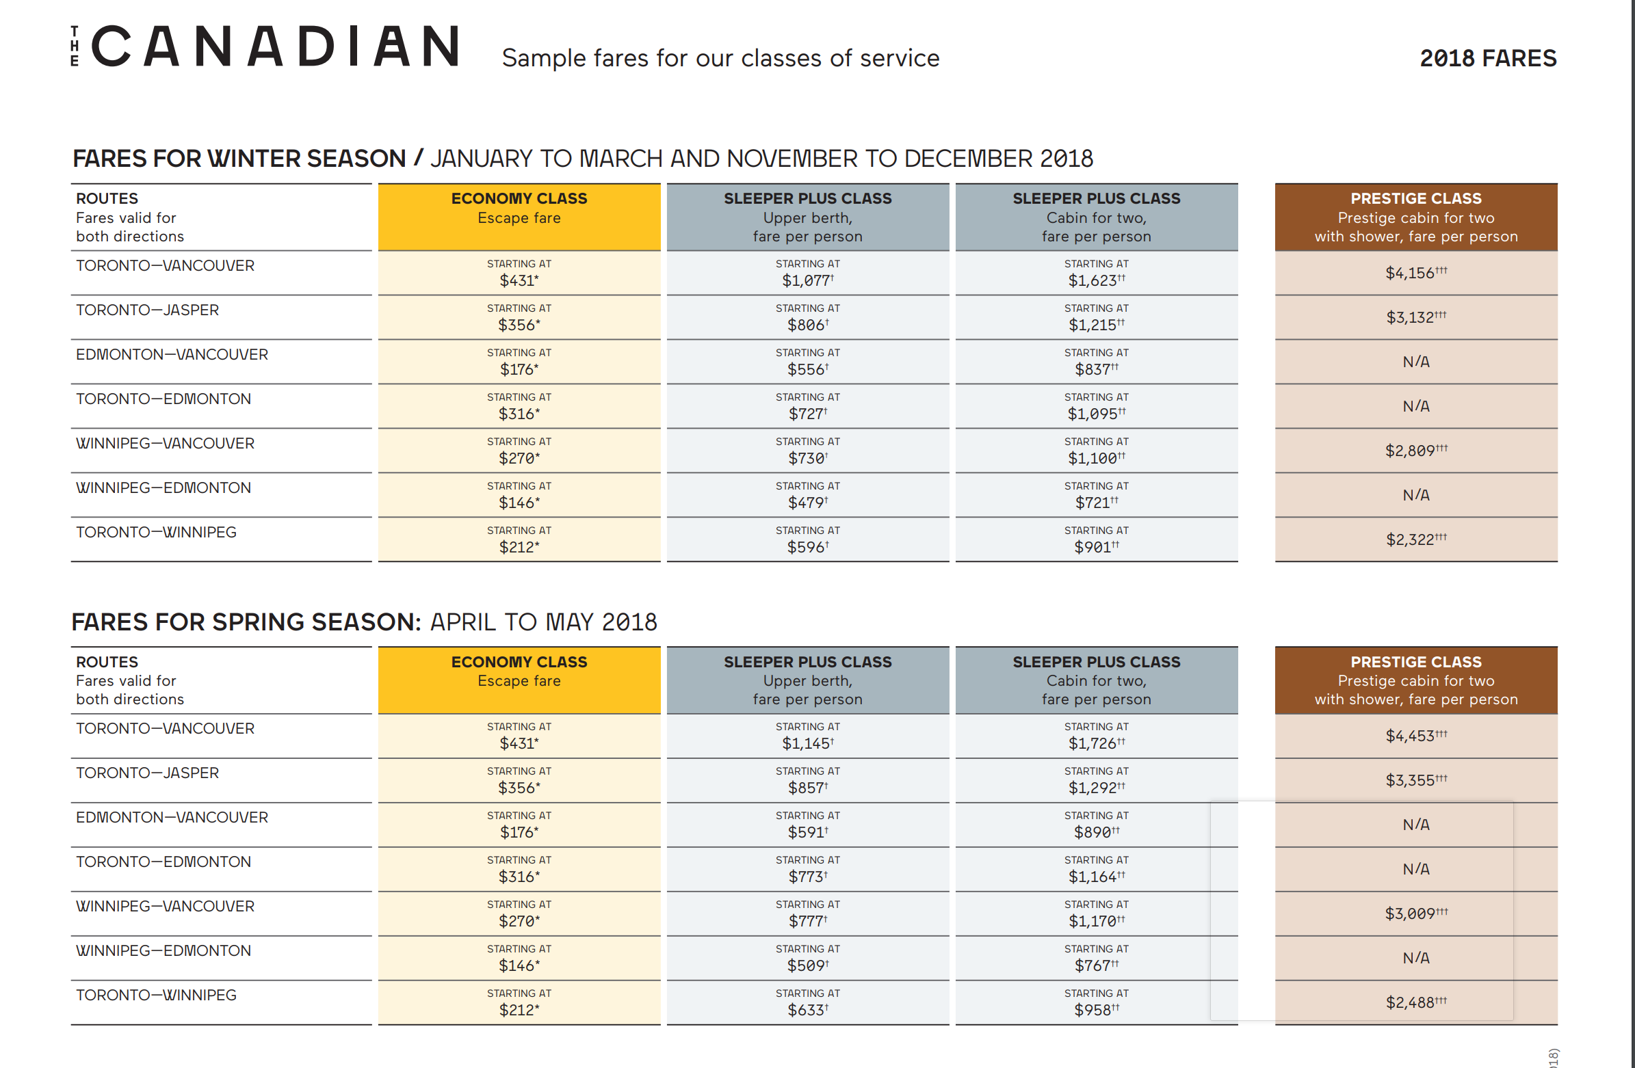
Finance calculation (train ticket price)
Sources: VIA price list: https://m.viarail.ca/sites/all/files/media/lecanadien/price_list_en_2018.pdf?ga_pdf=compare-prices

Slide 25
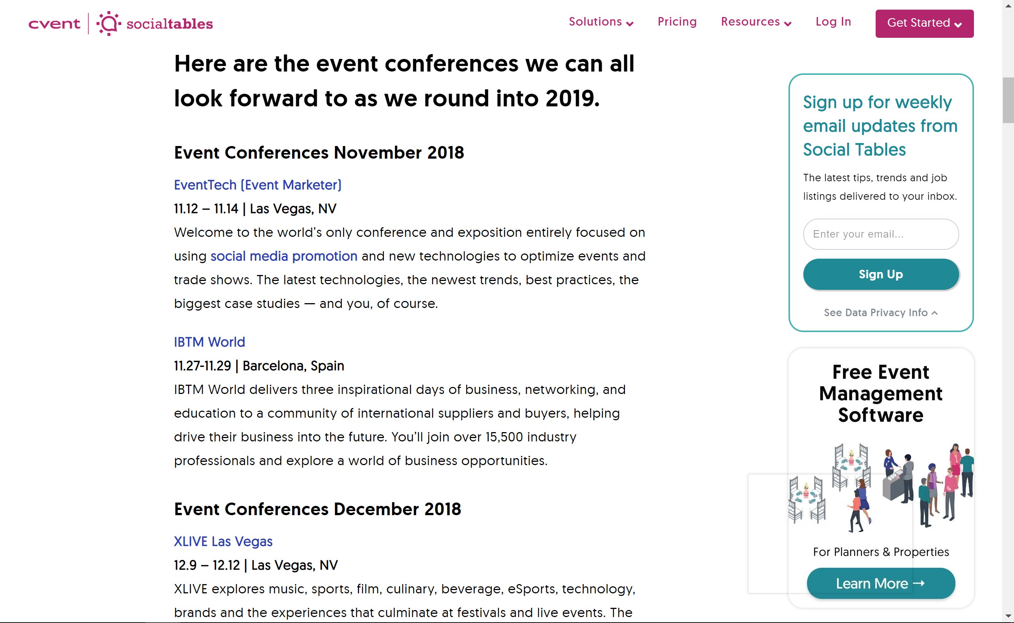
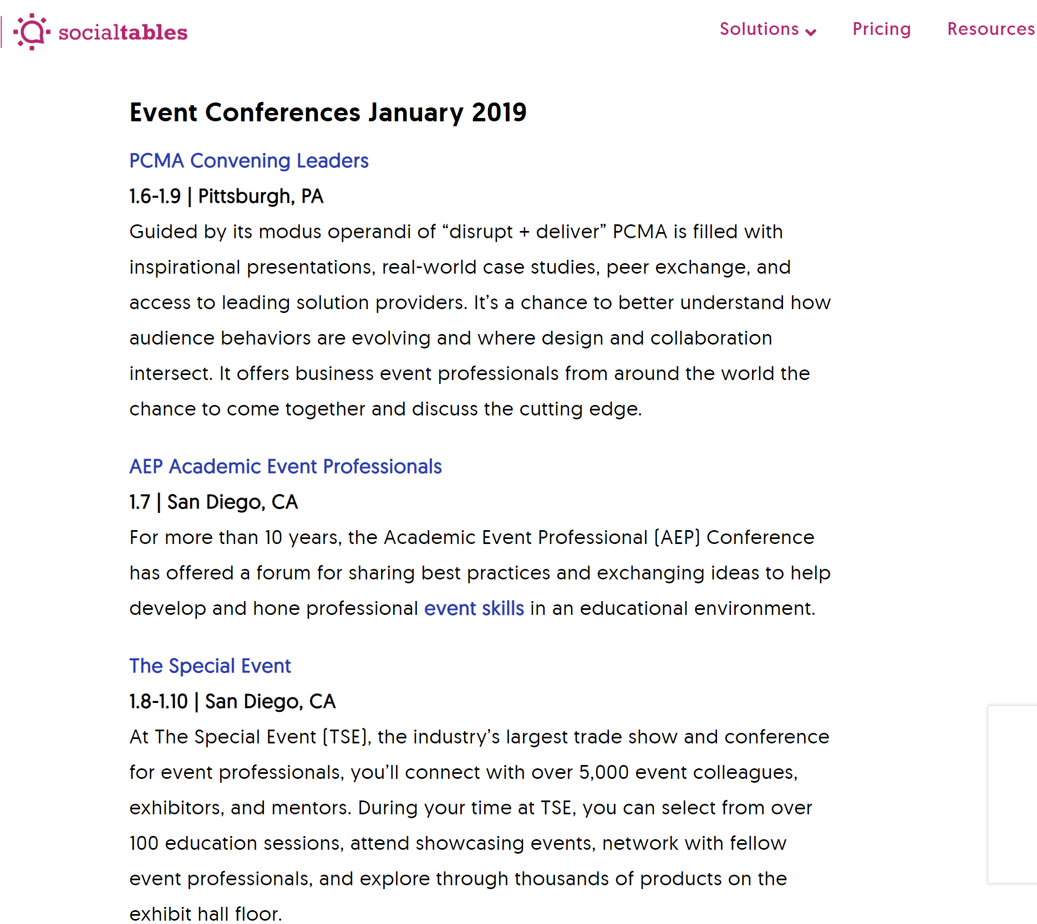
Conferences example
Notes:
Back up

Slide 26
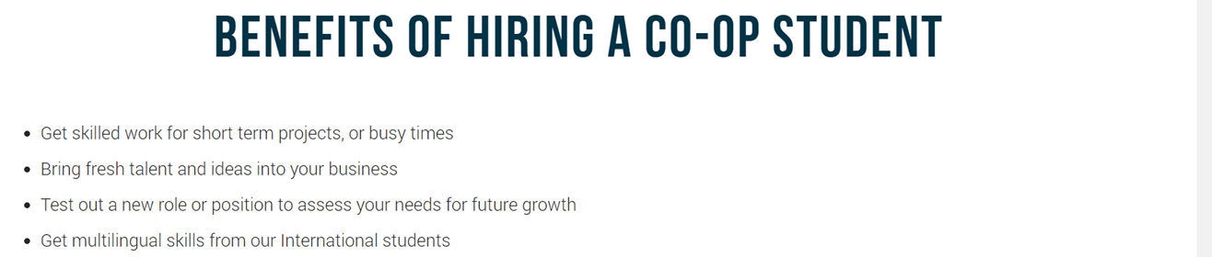
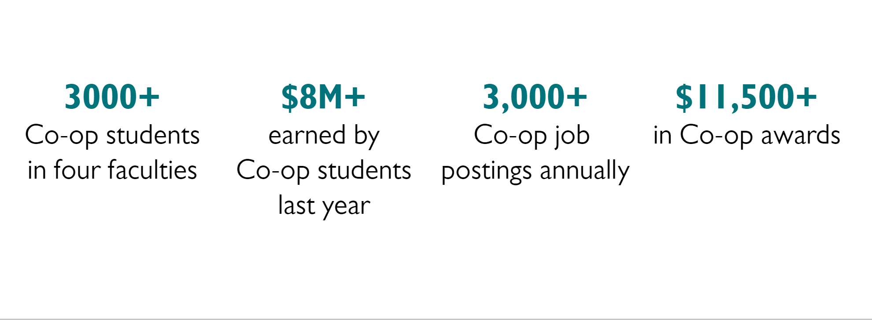
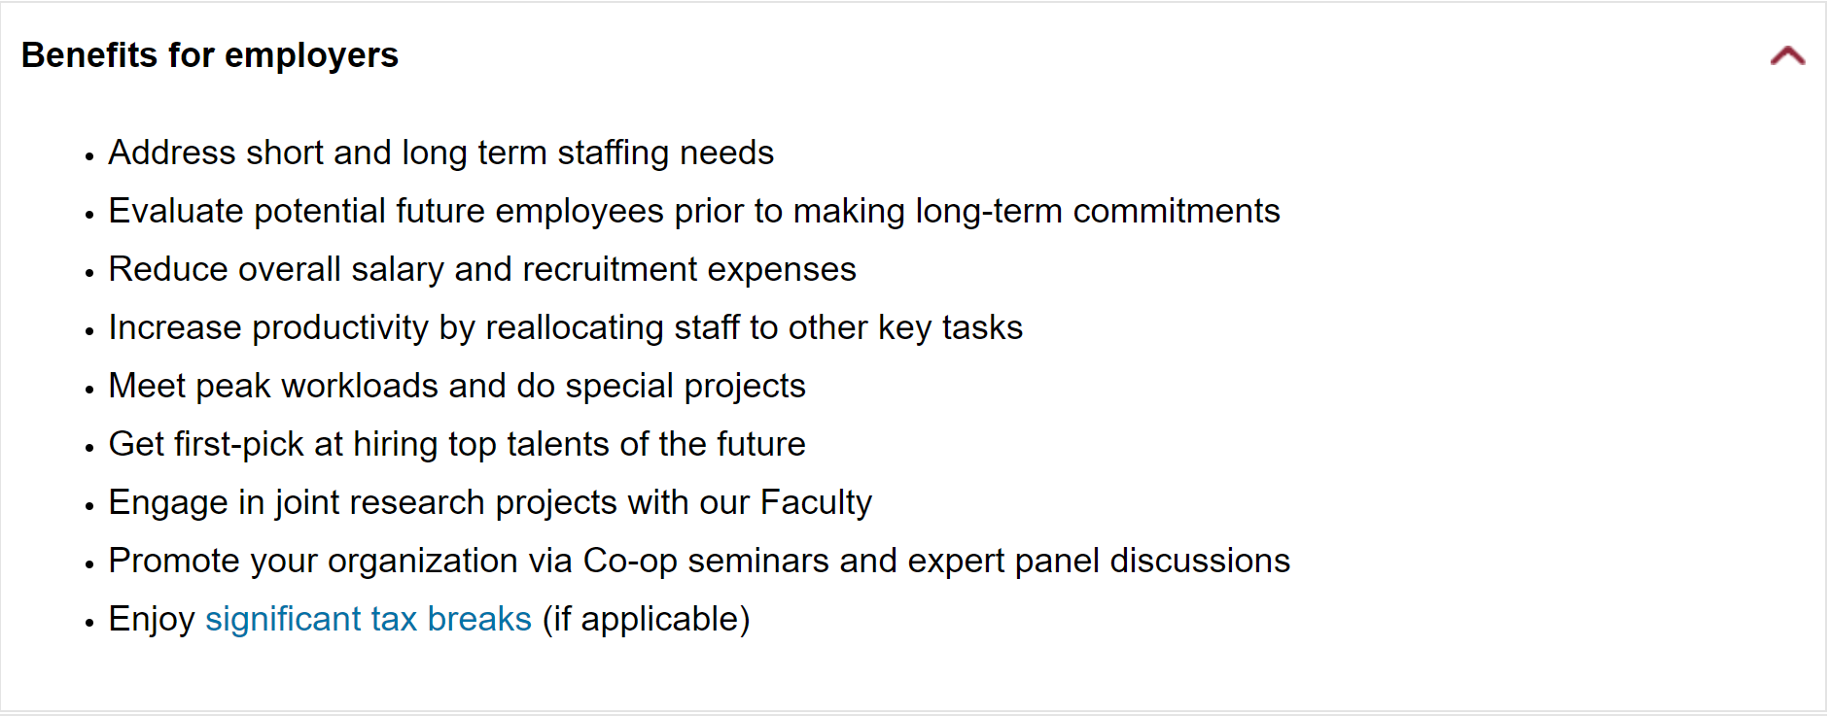
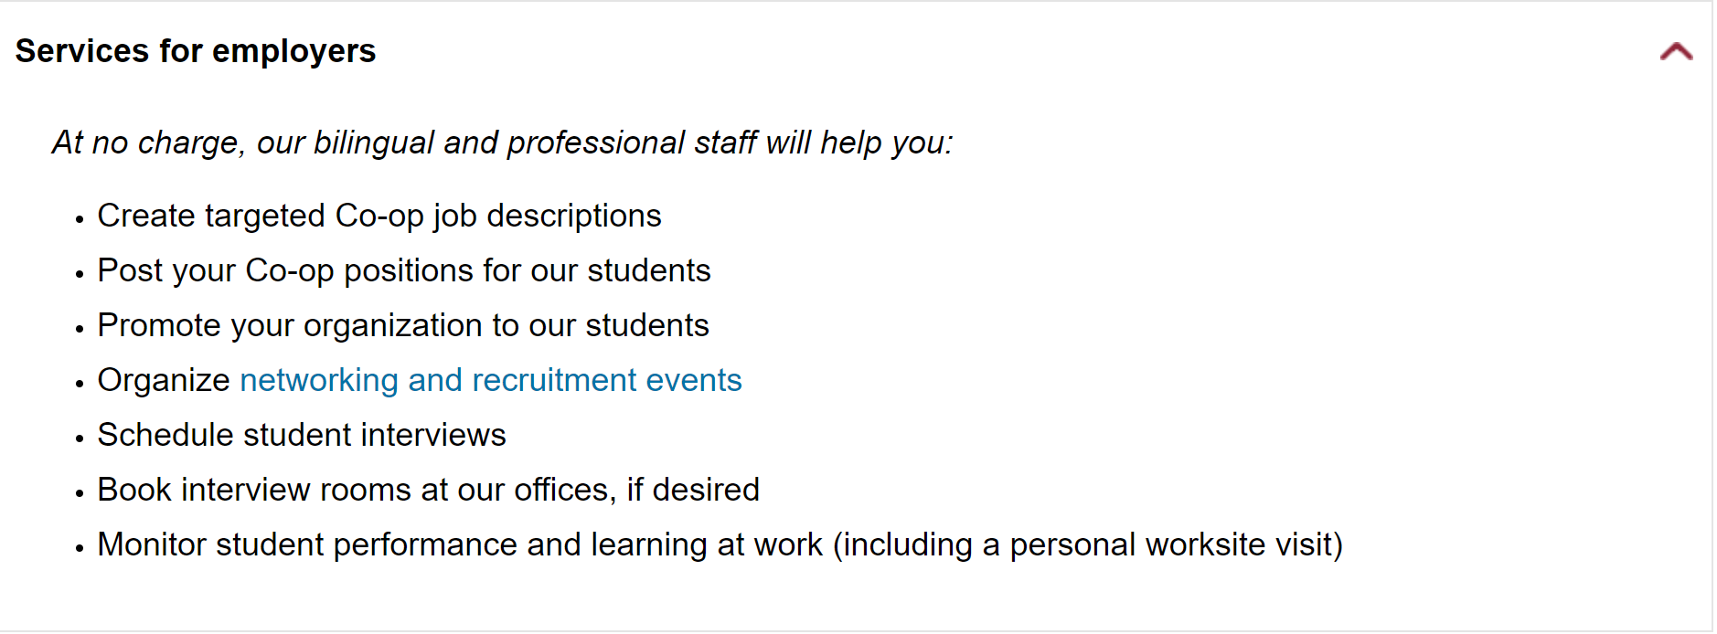
Co-op example – Concordia University

Slide 27
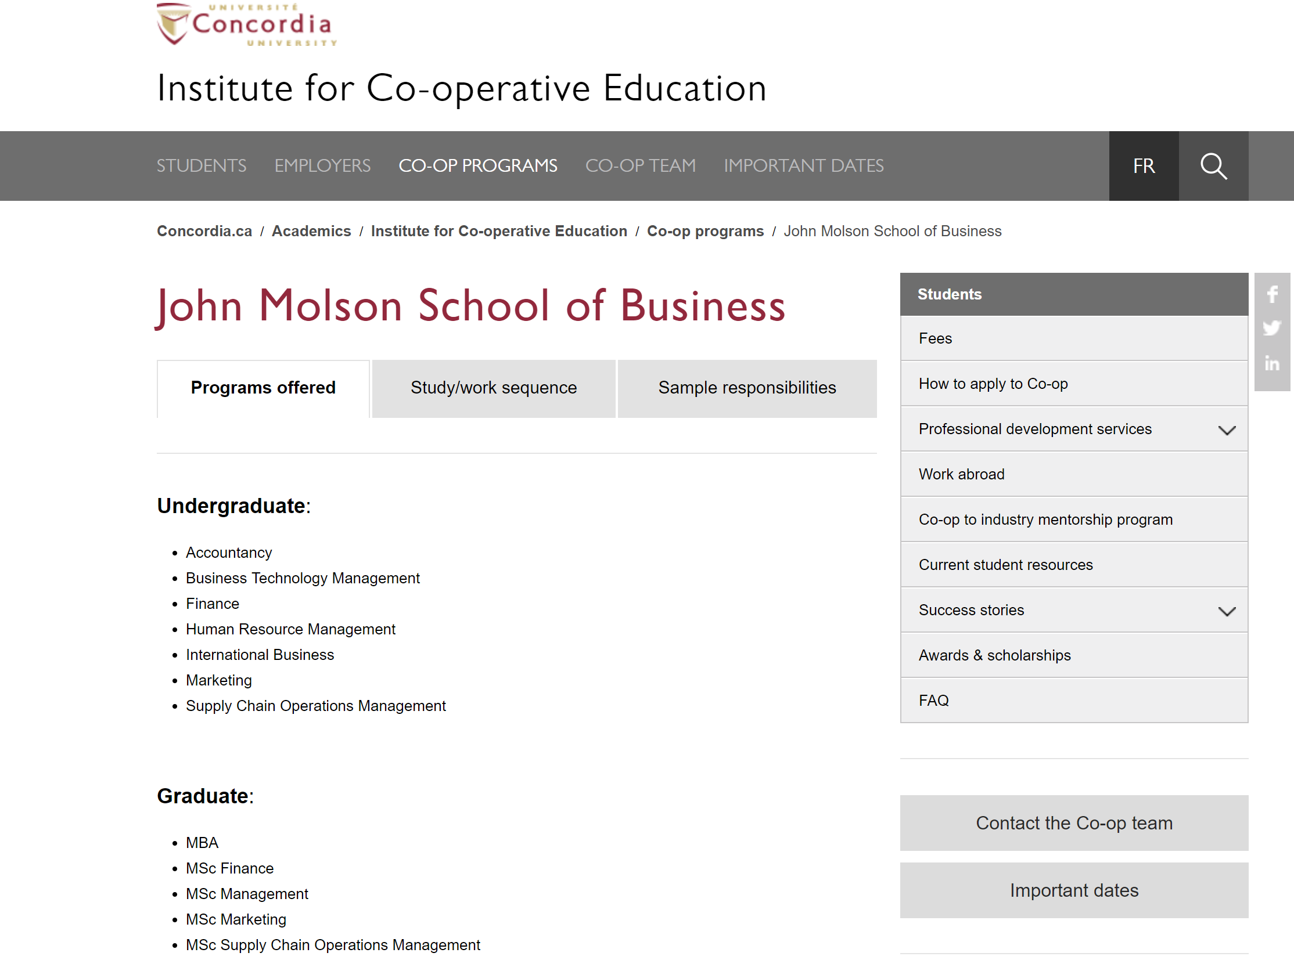
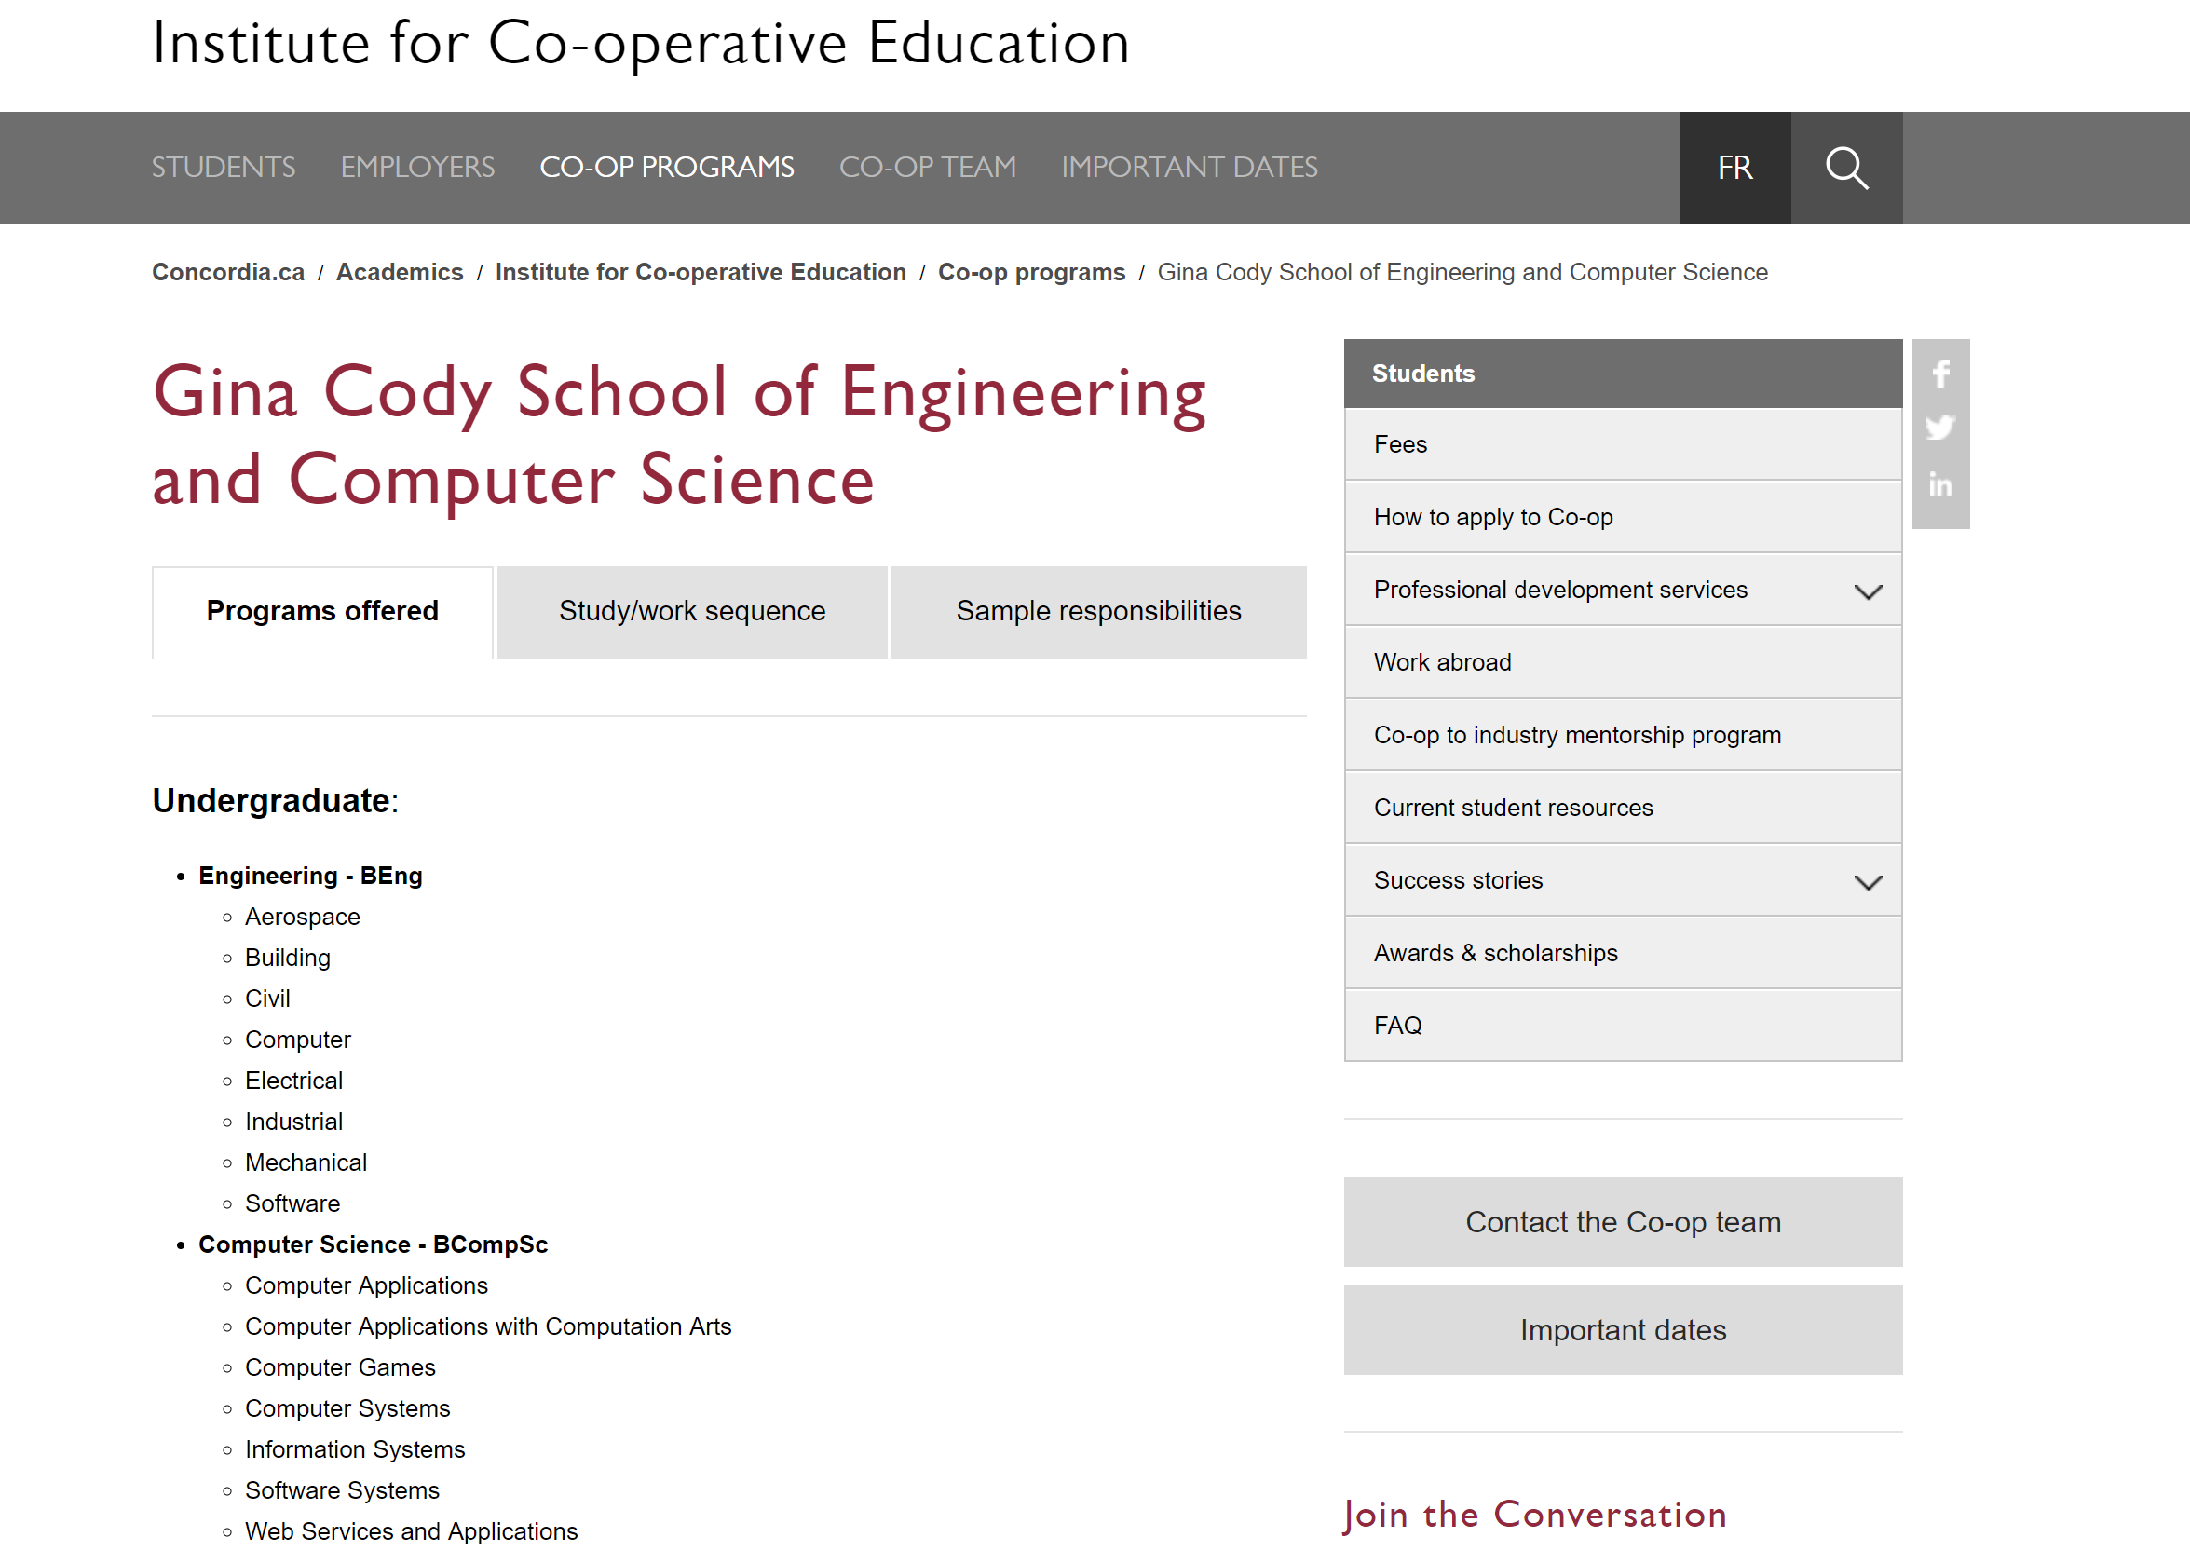
Co-op example – Concordia University

Slide 28

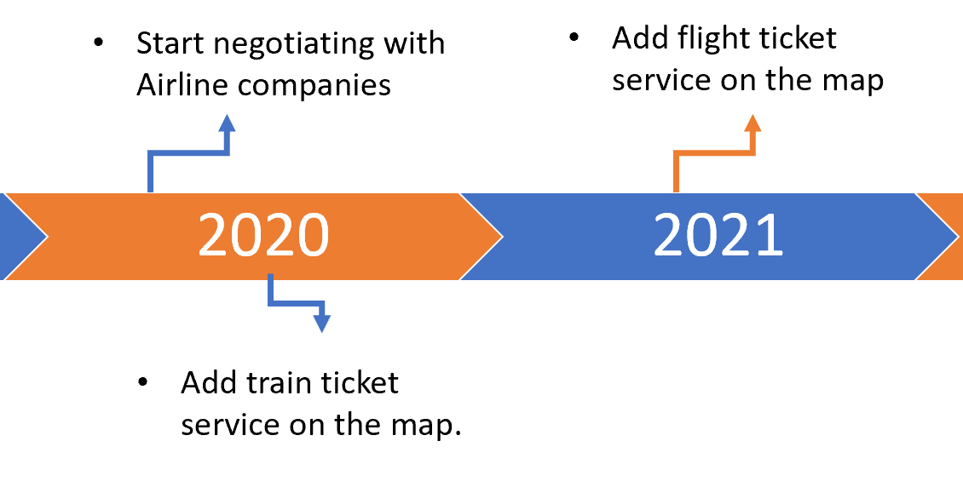
Staff distribution
Current employee requirement focus on Sales and IT
Needs to align with the requirement for implementation (negotiating and )
For year 2020, we plan to add train ticket service in our map and flight ticket service in 2021, which requires IT expertise for successful implement.
Employees’ salary is considered in the fiancé calculation

